Slide 1
Basic Units of Computer Architecture
Some of this material can be found in Chapter 3 of Computer Architecture (Carter)
CSIT 301 (Blum)
1

Slide 2
Basic Units
There are three to five (depending on how you count) basic units that make up a computer
Arithmetic-Logic Unit (ALU) also known as the datapath
Control (ROM)
Memory (RAM)
Input
Output
Central Processing Unit (CPU)
Input/Output (I/O)
CSIT 301 (Blum)

Slide 3
Arithmetic/Logic Unit
So much of what goes on inside a computer is just holding of and/or movement of data, but the actual computation (the manipulation of data to generate “new” data) takes place in the ALU.
Because data is represented in binary form (1’s and 0’s), the ALU is mainly comprised of logic gates, circuits made from transistors that take inputs (combinations of highs and lows) and produce outputs (different combinations of highs and lows).
Logic in which the output depends solely on the input is called combinatorial.
CSIT 301 (Blum)

Slide 4
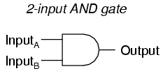
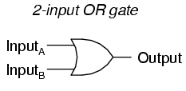
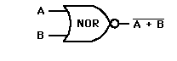
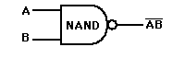
Logic Gates and Boolean operators
There is a correspondence between logic gates and Boolean operators
  AND: when two or more Boolean expressions are ANDed, both must be true for the combination to be true.
  OR: when two or more Boolean expressions are ORed, if either one or the other or both are true, then the combination is true.
  NOT: takes one Boolean expression and yields the opposite of it, true → false and vice versa.
  NAND: equivalent to an AND followed by a NOT
  NOR: equivalent to an OR followed by a NOT
CSIT 301 (Blum)

Slide 5
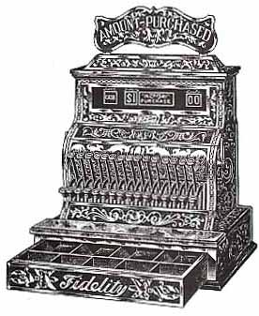
ALU Cont. (Registers and
Accumulators)
The ALU is not entirely combinatorial, it also has some sequential components, which can temporarily hold information.
These little holding units are known as registers.
The primary registers associated with the ALU go by the name accumulators.
CSIT 301 (Blum)

Slide 6

Hierarchy of bit holders
An electronic circuit that holds a single bit (a 1 or a 0) is called a flip-flop.
A small collection of flip-flops (8 or 16 or 32, etc.) is called a register.
  A counter is a kind of register that in addition to holding bit values can increment the number they represent.
  A shift register can hold a number as well as “shift” it.
    00101101
    01011010
    10110100, etc.
A collection of registers along with a way to address (select out) a particular register is called memory.
CSIT 301 (Blum)

Slide 7


Control Unit
Control is responsible for determining what action is to be performed on what data.
If the action is a calculation, then control will deliver the necessary data to the ALU, inform the ALU what particular action is to be performed, and then directs the output to the appropriate location.
CSIT 301 (Blum)

Slide 8
Control Cont.
All of the other units of a computer have “control inputs” that determine whether or not they are active and what particular action they will perform (if they can do more than one thing).
Control takes code down to this lowest level of making the appropriate control inputs high or low, active or inactive.
  Not all devices are active when the control input is high, some devices are “active low.”
CSIT 301 (Blum)

Slide 9
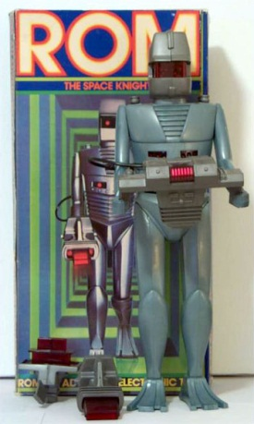
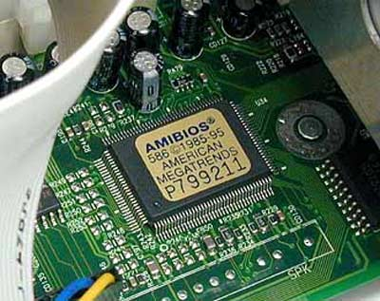

Control is ROM
At a high level, instructions may be arranged in new and different orders (this after all is what makes the computer programmable). But at the low level the control sequences for a given instruction do not change.
Control sequences are thus made of Read Only Memory (ROM) which are reprogrammed rarely if at all.
CSIT 301 (Blum)

Slide 10
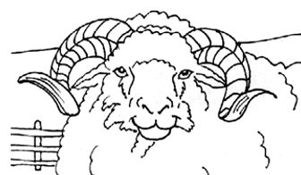
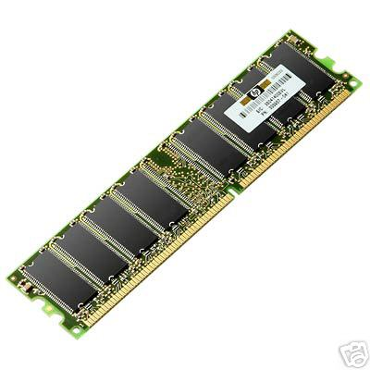
Memory
Memory consists of circuits whose primary purpose is to hold information, but only temporarily.
Memory holds the data that the processor has just acted on, is acting on or will soon act on.
When we use the term memory, we usually mean Random Access Memory (RAM).
CSIT 301 (Blum)

Slide 11

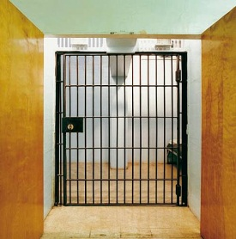
Memory
Memory is collection of holding cells (like registers). Each cell has an address.
Address | Value
0000 | 10010100
0001 | 01010010
0010 | 00101100
0011 | 01011100
0100 | 01100110
…
CSIT 301 (Blum)

Slide 12
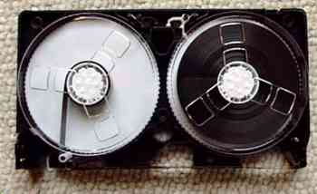
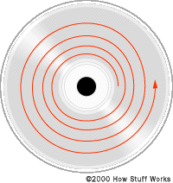
Random Access
The data in any holding cell can be accessed immediately for purposes of reading or writing by supplying its address.
  Any random site can be “immediately” accessed.
  As opposed to sequential access in which one must pass through all intermediate data between one’s current location and the next desired location.
    VCR tapes are sequential;
    DVDs are random access (they support scene selection and don’t have to be rewound).
CSIT 301 (Blum)

Slide 13
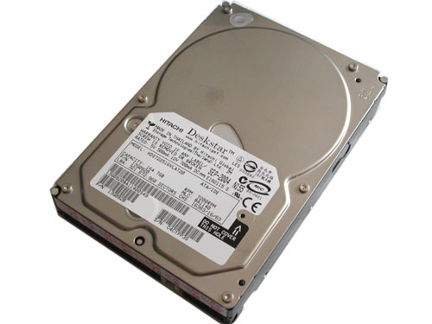
Memory versus Storage
Memory is a temporary holding place that interacts fairly directly with the processor.
  Memory is volatile, the holding of the information requires power. No power, no data held.
Longer term holding of data not currently being processed is done in storage (hard disks, floppy disks, CDs).
In this “basic units” picture of the computer storage belongs to the Input/Output unit.
CSIT 301 (Blum)

Slide 14

Input / Output
The Input unit allows programs and data to be entered into the computer.
The Output unit allows the results of processing to be exported to the outside world or other devices or saved to be used later.
This other device may be in the same case as the processor, but it is output as far as the processor and memory are concerned. Thus the hard drive is both an input and an output device in this picture.
CSIT 301 (Blum)

Slide 15
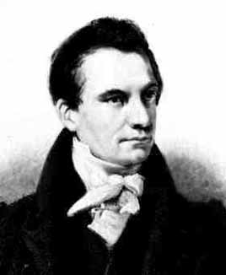
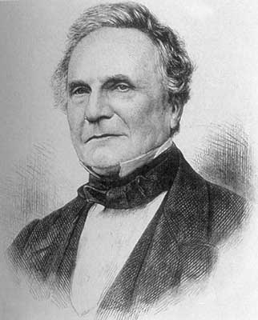

Charles Babbage
In the early 1800’s Charles Babbage designed two machines: first the Difference Engine and then the Analytical Engine that were mechanical machines capable of performing calculations.
The Difference Engine, most (but not all) of which was built in Babbage’s time, was a special purpose machine (i.e. it could only do particular calculations).
The Analytical Engine, which was designed but not built in Babbage’s time, was more ambitious in that it was programmable.
Who am I? What am I doing here?
CSIT 301 (Blum)

Slide 16
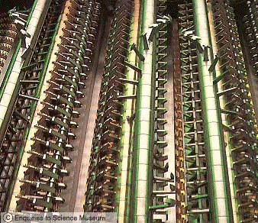
Babbage’s “Mill”
Built later based on Babbage’s specifications.
CSIT 301 (Blum)

Slide 17
Babbage’s design
Babbage’s design had the basic units we have been describing.
He conceived of it as having four components:
  the store (memory)
  the mill (computational unit, control + ALU)
  the input section (punched card reader)
  the output section (punched and printed output).
CSIT 301 (Blum)

Slide 18
Babbage (Cont.)
Babbage’s engines were entirely mechanical and were comprised of gears and cogs and such.
The store held 1000 words of 50 decimal digits used to hold variables and results.
The mill (processor) could take data from the store, add, subtract, multiply or divide them, and return the answer to the store.
CSIT 301 (Blum)

Slide 19
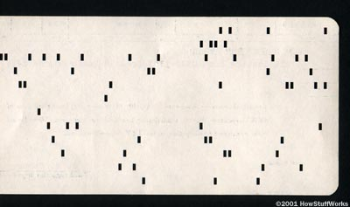
Babbage Input and Output
The engine’s input was from punched cards.
  Punch cards started being used in industry (weaving) since the early 1800’s. They disappeared in the 1980’s.
The data input was not simply data from the calculations but also data for instructions, making the engine programmable.
Instructions included being able to test whether a number was positive or negative (an if).
The engine’s output could be punched into a copper engraver's plate producing a hardcopy.
CSIT 301 (Blum)

Slide 20
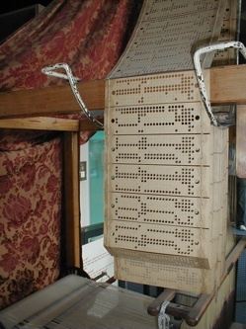
Jacquard Loom Punch Card
CSIT 301 (Blum)

Slide 21
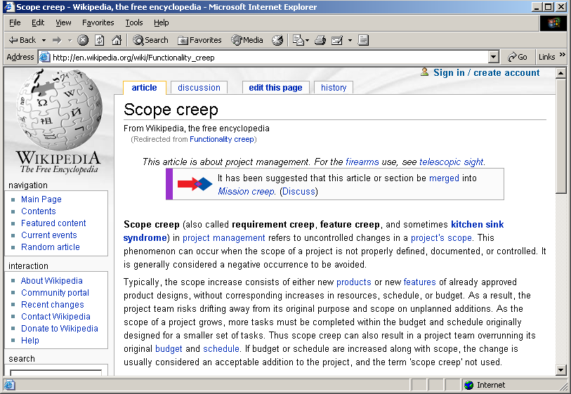
Babbage’s project suffered scope creep
CSIT 301 (Blum)

Slide 22
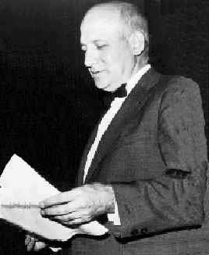
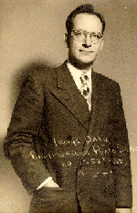
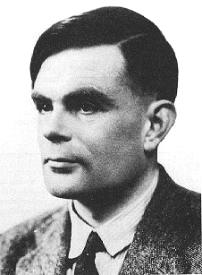
Fast forward a hundred years
In the 1940’s the Electronic Numerical Integrator And Computer (ENIAC) was built at the Moore School of the University of Pennsylvania.
It was completed in 1946 at the Moore School of the University of Pennsylvania.
The two driving forces behind it were John W. Mauchly and J. Presper Eckert.
There were other computers built during WWII notably the one developed at Bletchley Park, UK to aid in their code breaking mission.
Who am I? What am I doing here?
CSIT 301 (Blum)

Slide 23
ENIAC
The ENIAC consisted of 17,480 vacuum tubes operating at 100,000 pulses per second.
  Think of a vacuum tube as a “souped up light bulb.”
Vacuum tubes play the same role that transistors do in modern computers (one can use them to “realize” logic gates)
  The switch from vacuum tubes to transistors marked a dramatic shift in computer size and speed. People talk about the computers as belonging to different “generations.” Moving to transistors is a generational shift.
  The Pentium 4 processor introduced in 2000 had 42,000,000 transistors. The Itanium 2 in 2004 had 592,000,000 transistors. The size and power requirements of vacuum tubes would have prohibited these kind of numbers. The more recent Core i7 processor has a transistor count is 731 Million.
CSIT 301 (Blum)

Slide 24
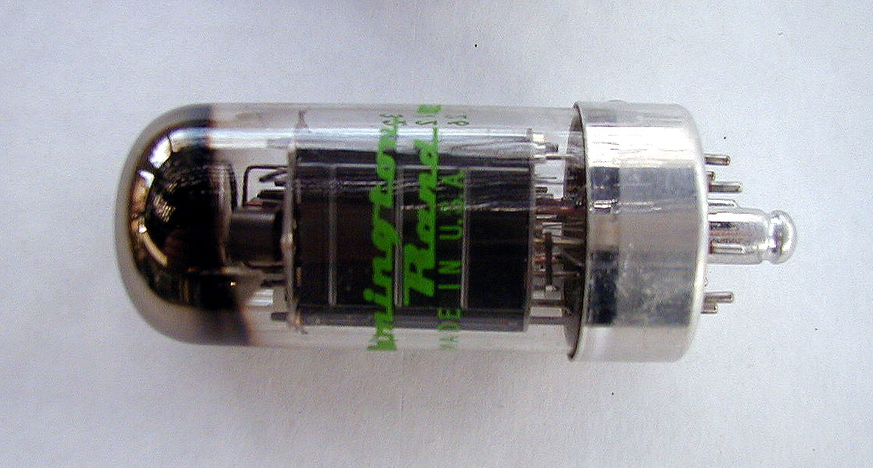
Vacuum tube
CSIT 301 (Blum)

Slide 25
Programming
One drawback to the ENIAC was the way it was programmed — with wires.
A new program required rewiring.
Mauchly, Eckert and John von Neumann discussed designs of future computers (like EDVAC) in which the programs (instructions) would be stored in the computer’s memory.
CSIT 301 (Blum)

Slide 26
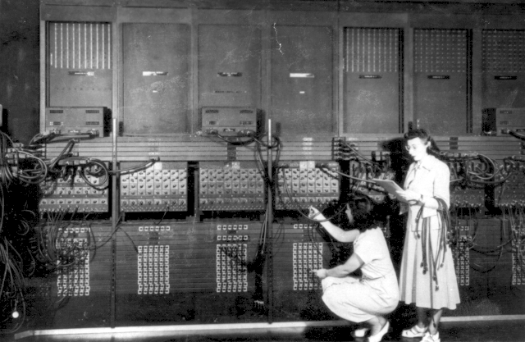
Early Programmers
CSIT 301 (Blum)

Slide 27
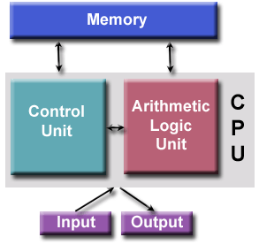
Von Neumann Architecture
John von Neumann was a consultant to the ENIAC project. The team discussed changing the way computers were programmed. Von Neumann publicized and popularized these ideas.
The instructions could be converted into numbers and placed in memory along with the data. This is known as the stored program concept.
The combination of the basic units (ALU, control, memory, input and output) and the stored program concept give one the “von Neumann architecture.”
CSIT 301 (Blum)

Slide 28
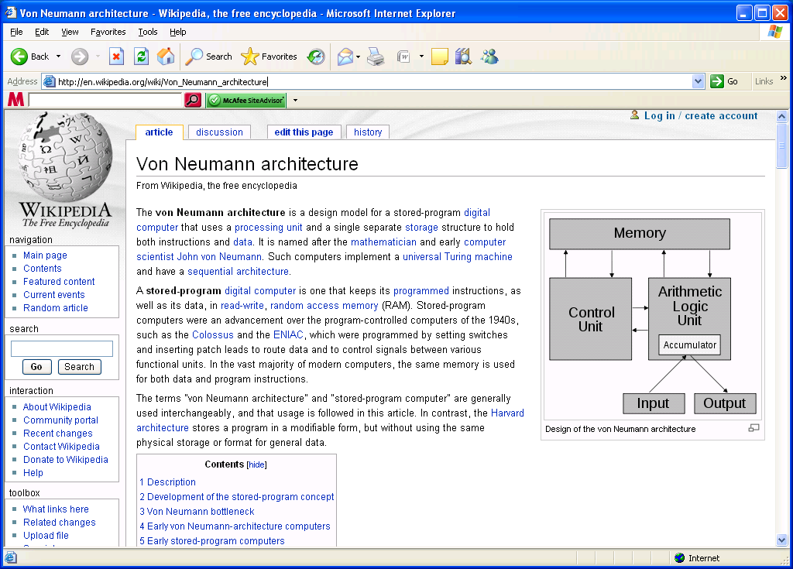
CSIT 301 (Blum)

Slide 29
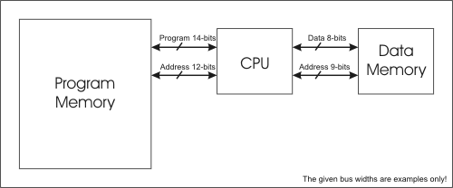
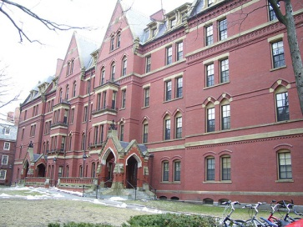
Harvard architecture
In the von Neumann architecture, the instructions and data are held in the same memory.
A variation on this, known as the Harvard architecture, has the instructions and data held in separate memories.
A more modern variation on the Harvard architecture is to have the data and instructions in the same main memory but to place them in separate caches.
CSIT 301 (Blum)

Slide 30
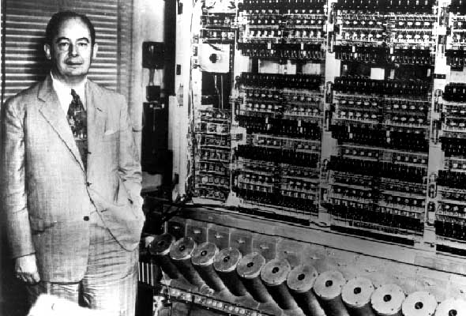
John von Neumann
CSIT 301 (Blum)

Slide 31
Micro-code (note: micro, not macro)
What’s held in the memory is a low-level (assembly or machine code) instruction which may have resulted when some high-level language program was compiled.
Below that is micro-code, the instructions at the lowest level, those control signals fed directly to the hardware.
Any higher-level instructions (including assembly) must ultimately be converted to a lower level by control.
A single machine-language instruction (like Load Accumulator A) typically consists of several micro-code instructions.
  Similarly a single high level instruction (such as principle = principle*(1+interestRate) often consists of several assembly level instructions.
CSIT 301 (Blum)

Slide 32
Where is microcode stored?
It used to literally be wired in (hence the term “hard wired”).
Typically it stored in ROM.
If the code is stored in EEPROM, it can be changed; this is known as microprogramming.
  EEPROM: Electrically Erasable Programmable ROM
But this is something one does on a rare occasion
Sometimes referred to as “firmware,” an intermediate between software and hardware.
CSIT 301 (Blum)

Slide 33

Machine language
Machine language is a level above micro-code
The instructions are numbers, which really are the addresses of the micro-code instruction in ROM.
  Machine language is typically machine dependent. The locations in ROM of the microcode vary from one make of a computer to the next.
A mnemonic version of machine language is called assembly language.
CSIT 301 (Blum)

Slide 34
Getting down to hardware’s level
High-level programs are translated into assembly language or machine language by a compiler. Assembly language programs are translated into machine language by an assembler.
Each processor has its own unique machine language. Thus code must be rewritten or at least recompiled to run on different processor (different hardware).
CSIT 301 (Blum)

Slide 35
A simple design
Next we will show a computer design.
It uses a very basic “bus architecture.”
A bus is a shared path used to transmit and receive information.
CSIT 301 (Blum)

Slide 36
Bus
Keyboard encoder
Input port 1
Accumulator
ALU
Flags
Input port 2
Prog. counter
TMP
Mem.Add.Reg.
B
Memory
C
MDR
Output port 3
Display
Instr. Reg.
Output port 4
CSIT 301 (Blum)
Control

Slide 37
One Bus, Two Bus
In this very primitive architecture, there is only one bus.
Recall that memory can be thought of as values located at addresses. Here the same bus is used for both data (values) and addresses.
This will make accessing memory (reading or writing) a two-step process – deal with the address, then deal with the data.
  Dealing with memory is always a two step process, but in this architecture the one and only bus is tied up for both step (no parallelism allowed).
That is not the usual case. Most architectures have an address bus and a data bus.
CSIT 301 (Blum)

Slide 38

Input ports
Keyboard encoder: converts key pressed into corresponding string of bits (ASCII)
Input port 1: where keyboard data is entered, usually contains some memory (a buffer) where data is held until the processor is ready for it.
Input port 2: where non-keyboard data is entered.
CSIT 301 (Blum)

Slide 39
Program counter
The program counter points to the current line of the program (which is stored in memory)
This design shows arrows connecting the “PC” to and from the bus, why?
  Sometimes the next instruction to be executed is not the next line of code in memory, such as
    If
    Loops
    Subroutines, functions, etc.
CSIT 301 (Blum)

Slide 40
MAR, MDR and Memory
MAR (Memory Address Register) holds the address of the memory location being read from or written to
  Not necessarily same as program counter
Memory (RAM): the place where data and instructions are stored
MDR (Memory Data Register) holds the data that is being read from or written to memory
  Bi-directional connection to bus for reading and writing
CSIT 301 (Blum)

Slide 41
Instruction Register
Instruction register holds the instruction that is currently being executed.
A given line of assembly or machine language code involves several micro-code instructions, the instruction register holds onto the instruction until all of the micro-instruction steps are completed.
  It plays a role somewhat like the MAR but for ROM instead of RAM
CSIT 301 (Blum)

Slide 42
Controller/Sequencer
Executes the program at the lowest level.
Sends signals to the control pins of all the devices involved.
These lowest-level instructions are in ROM
Each assembly-level instruction has a numerical counterpart (machine language); the numerical counterpart is the address of the microcode for that instruction stored in ROM.
Not shown, controller connects to everything
CSIT 301 (Blum)

Slide 43

Accumulator and ALU
Accumulator: register used in conjunction with the ALU
Data upon which arithmetic or logic operations will eventually be performed is stored here; also the results of these are stored here.
ALU (Arithmetic Logic Unit) where operations that change the data (as opposed to just moving it around) are done.
CSIT 301 (Blum)

Slide 44

Flags
Flags are output from the ALU that are distinct from data (data output goes to Acc. A)
For example,
  A carry from an addition
  An indication of overflow
    These are needed for program control or to indicate possible errors
  The result of a logical comparison (<, >, =)
    These are needed for control (ifs, loops, etc)
CSIT 301 (Blum)

Slide 45
TMP, B and C
TMP is the other register used in conjunction with the ALU; the distinction is that answers are generally sent to Accumulator A
B and C are additional registers used for holding data temporarily
  They allow additional flexibility and reduce the amount that must be written to memory.
CSIT 301 (Blum)

Slide 46
Output ports
Output port a connection to the “outside world”
  Usually includes a buffer
  This design has one for displayed output and a second for other output (e.g. storage)
CSIT 301 (Blum)

Slide 47
Micro-code
Let us now examine the steps involved in the assembly (machine language) instruction Load Accumulator A.
CSIT 301 (Blum)

Slide 48
What do you mean by Load?
There are different types of Loads
  Load
    Instruction and address
    Data at specified address to be put in Acc. A
  Load immediate
    Instruction and data
    Data in instruction sent directly to Acc. A
  Load indirect
    Instruction and address of address
    The data in the location indicated by the instruction holds another address, and that address has the data to be placed in Acc. A
CSIT 301 (Blum)

Slide 49
Fetch Cycle
Address State: the value of the program counter (which recall is the address of line of the program to be performed) is put into memory address register.
Increment State: the program counter is incremented, getting it ready for the next time.
Memory State: the current line of the program is put into instruction register (so Control knows what to do).
CSIT 301 (Blum)

Slide 50
Execution cycle (Load Acc. A)
The remaining steps depend on the specific instruction and are collectively known as the execution cycle.
  Recall the instruction consisted of a load command and an address. A copy of the address is now taken from the instruction register over to the memory address register.
  The value at that address is loaded into Acc. A.
  For the load command, there is no activity during the sixth step. It is known as a "no operation" step (a "no op" or "nop").
CSIT 301 (Blum)

Slide 51
Bus
Keyboard encoder
Input port 1
Accumulator
ALU
Flags
Input port 2
Prog. counter
TMP
Mem.Add.Reg.
B
Memory
C
MDR
Output port 3
Display
Instr. Reg.
Output port 4
CSIT 301 (Blum)
Control

Slide 52
References
Computer Architecture, Nicholas Carter
Computer Organization and Design, David A. Patterson and John L. Hennessey
Digital Computer Electronics, Albert P. Malvino and Jerald A. Brown
http://en.wikipedia.org/wiki/Jacquard_loom
CSIT 301 (Blum)

